Slide 1
What are the effects of Reading Clubs on children in cocoa-growing communities?
Results from a pilot project in Côte d’Ivoire
January 2025

Slide 2
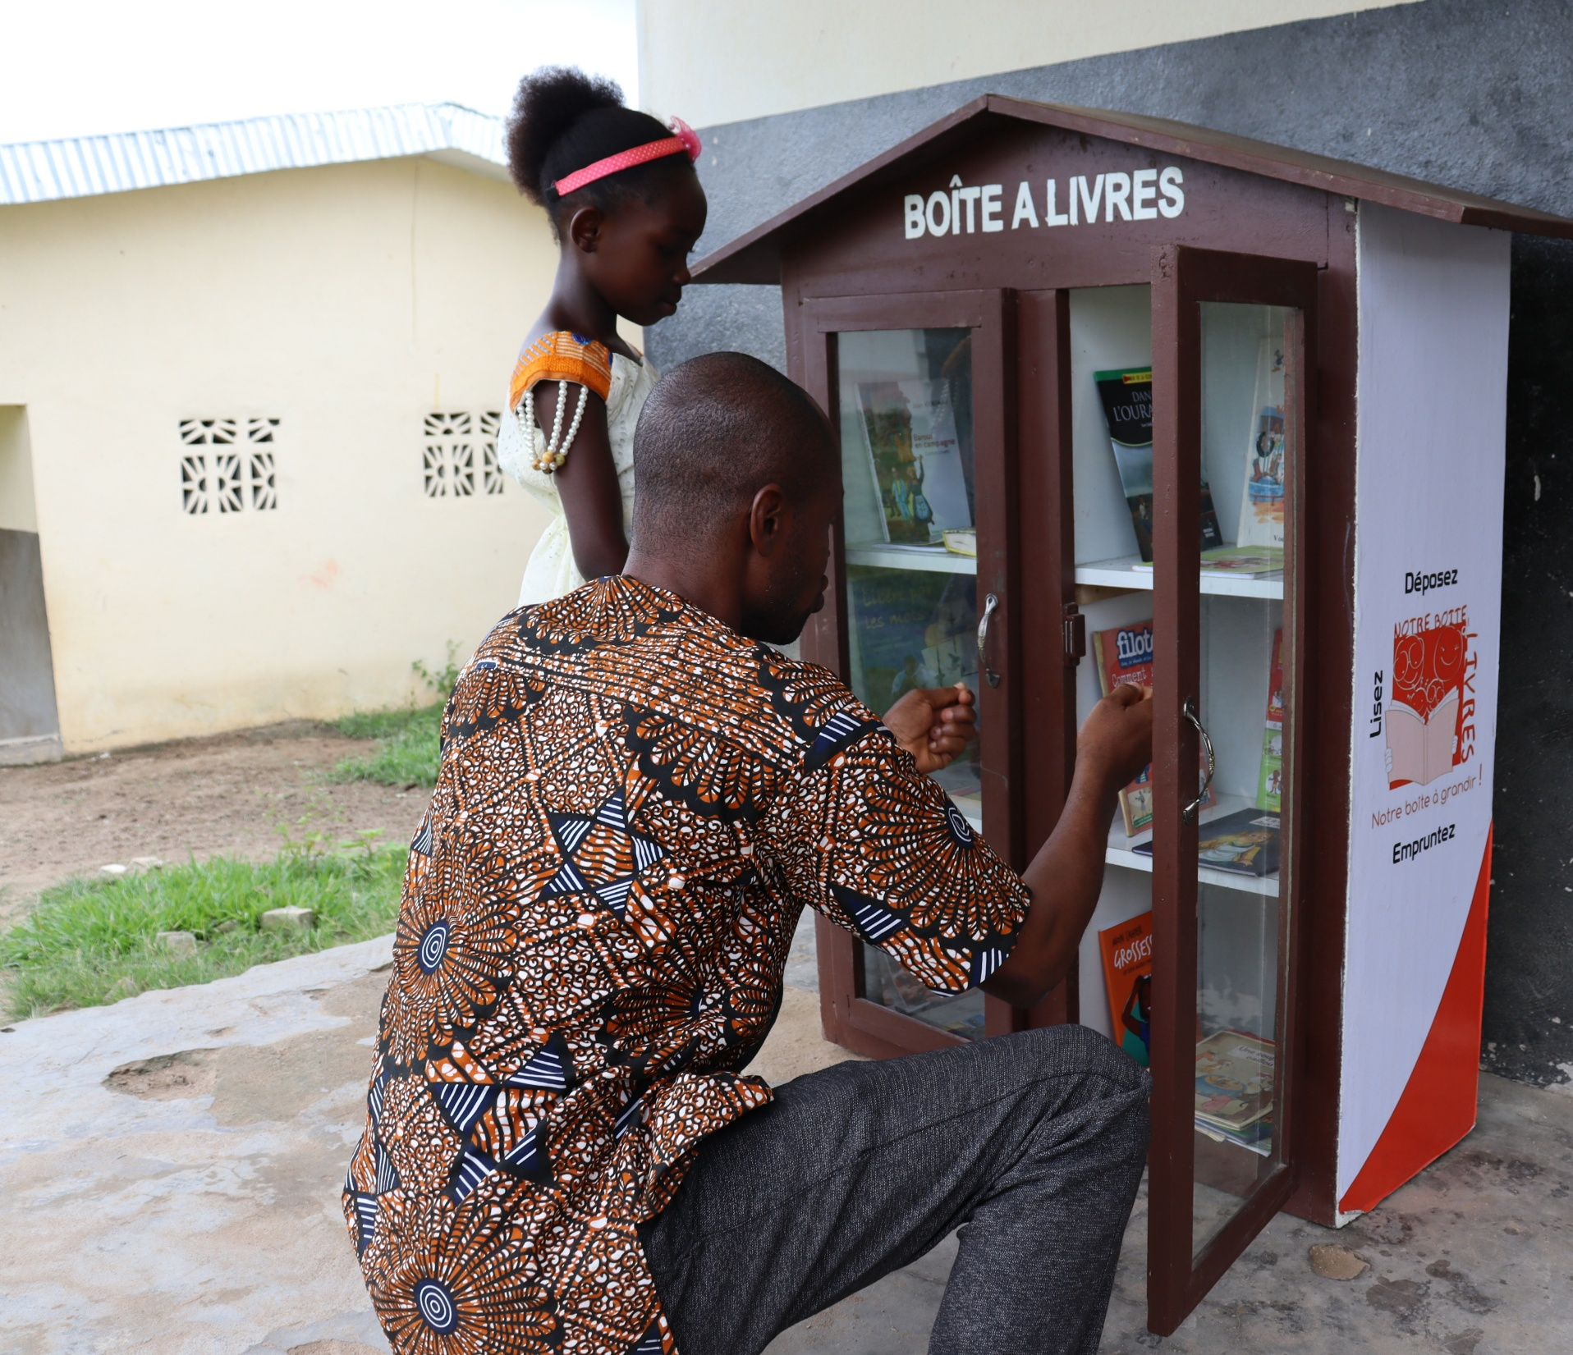
The Boîte à Livres reading club
Children participate in weekly interactive workshops run by trained facilitators
Children borrow books to read at home
Children participate in inter-community reading competitions to win prizes

Slide 3
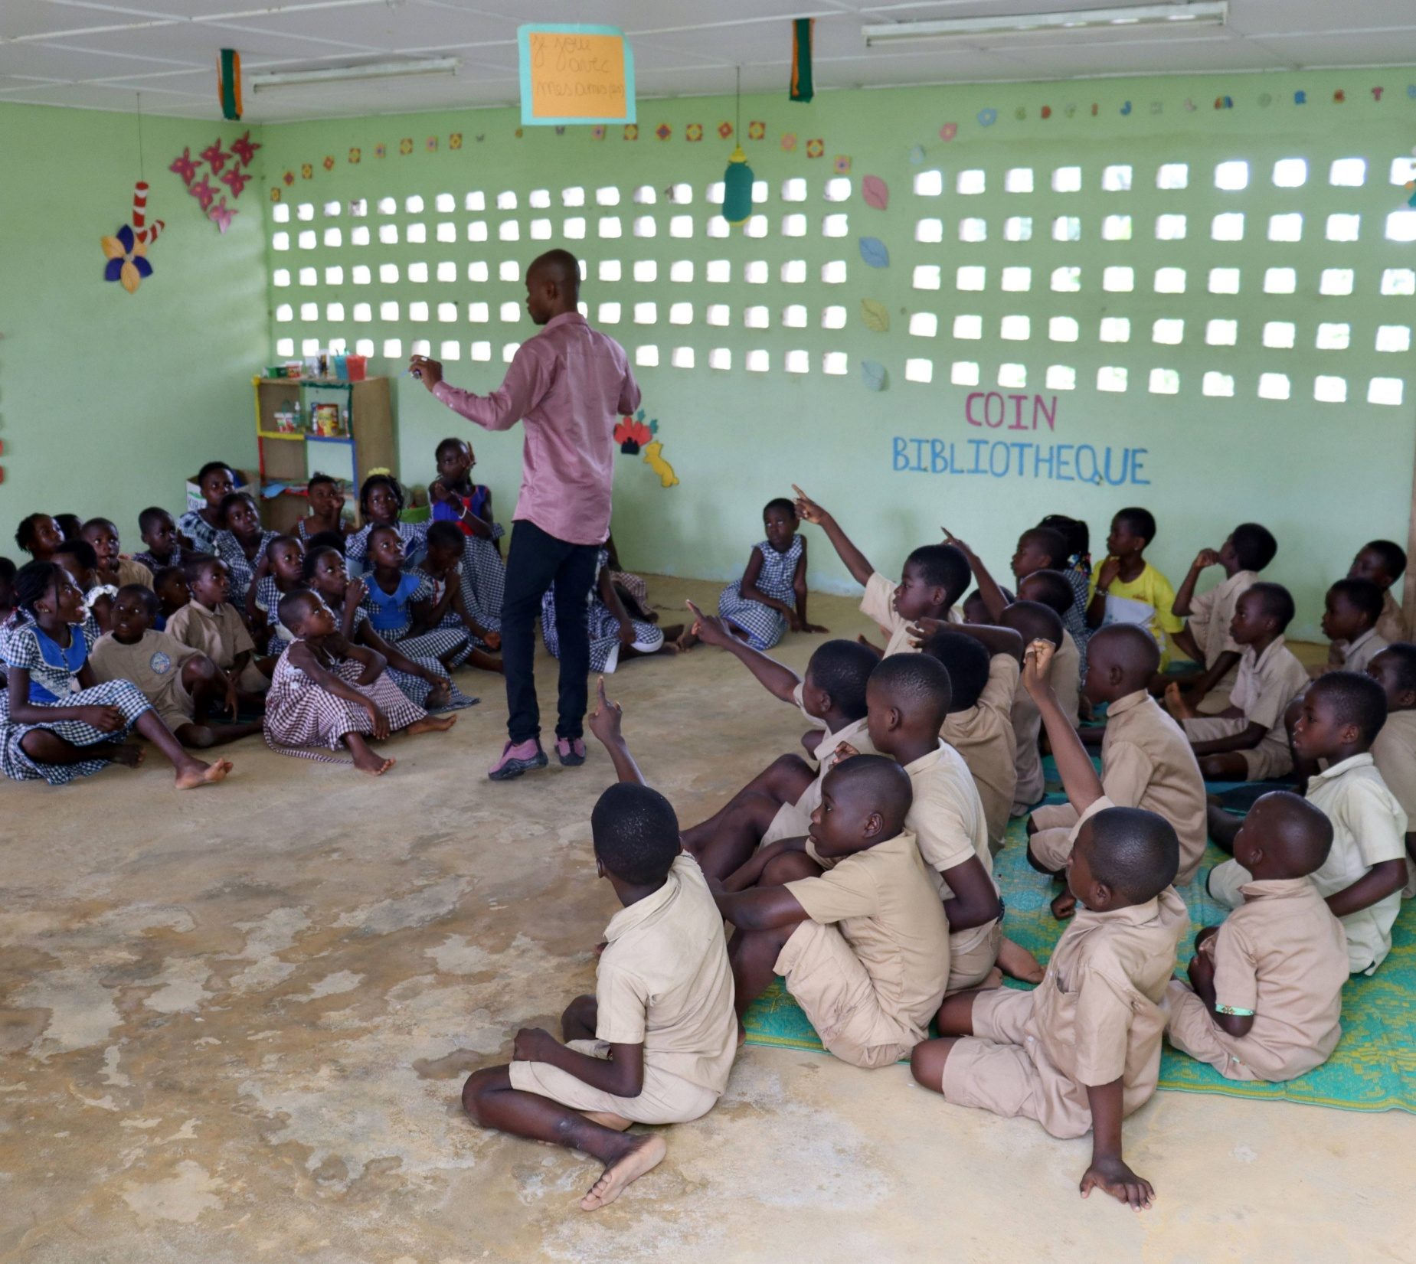
Project overview
Improve children’s reading skills
January 2023 – 2024
33 Boîte à Livres in 33 primary schools in cocoa-growing communities in Cote d’Ivoire

Slide 4
Research question
Is this approach effective in improving children’s reading skills and protecting them from child labour?
Research method
This research used a longitudinal study to compare 33 treatment and 33 control schools with similar characteristics.

Slide 5
Theory of change of the Boîte à Livres project
Improved reading skills
Boîte à Livres
Children’s participation in workshops and increased reading activities
Reduced time spent working in the fields

Slide 6
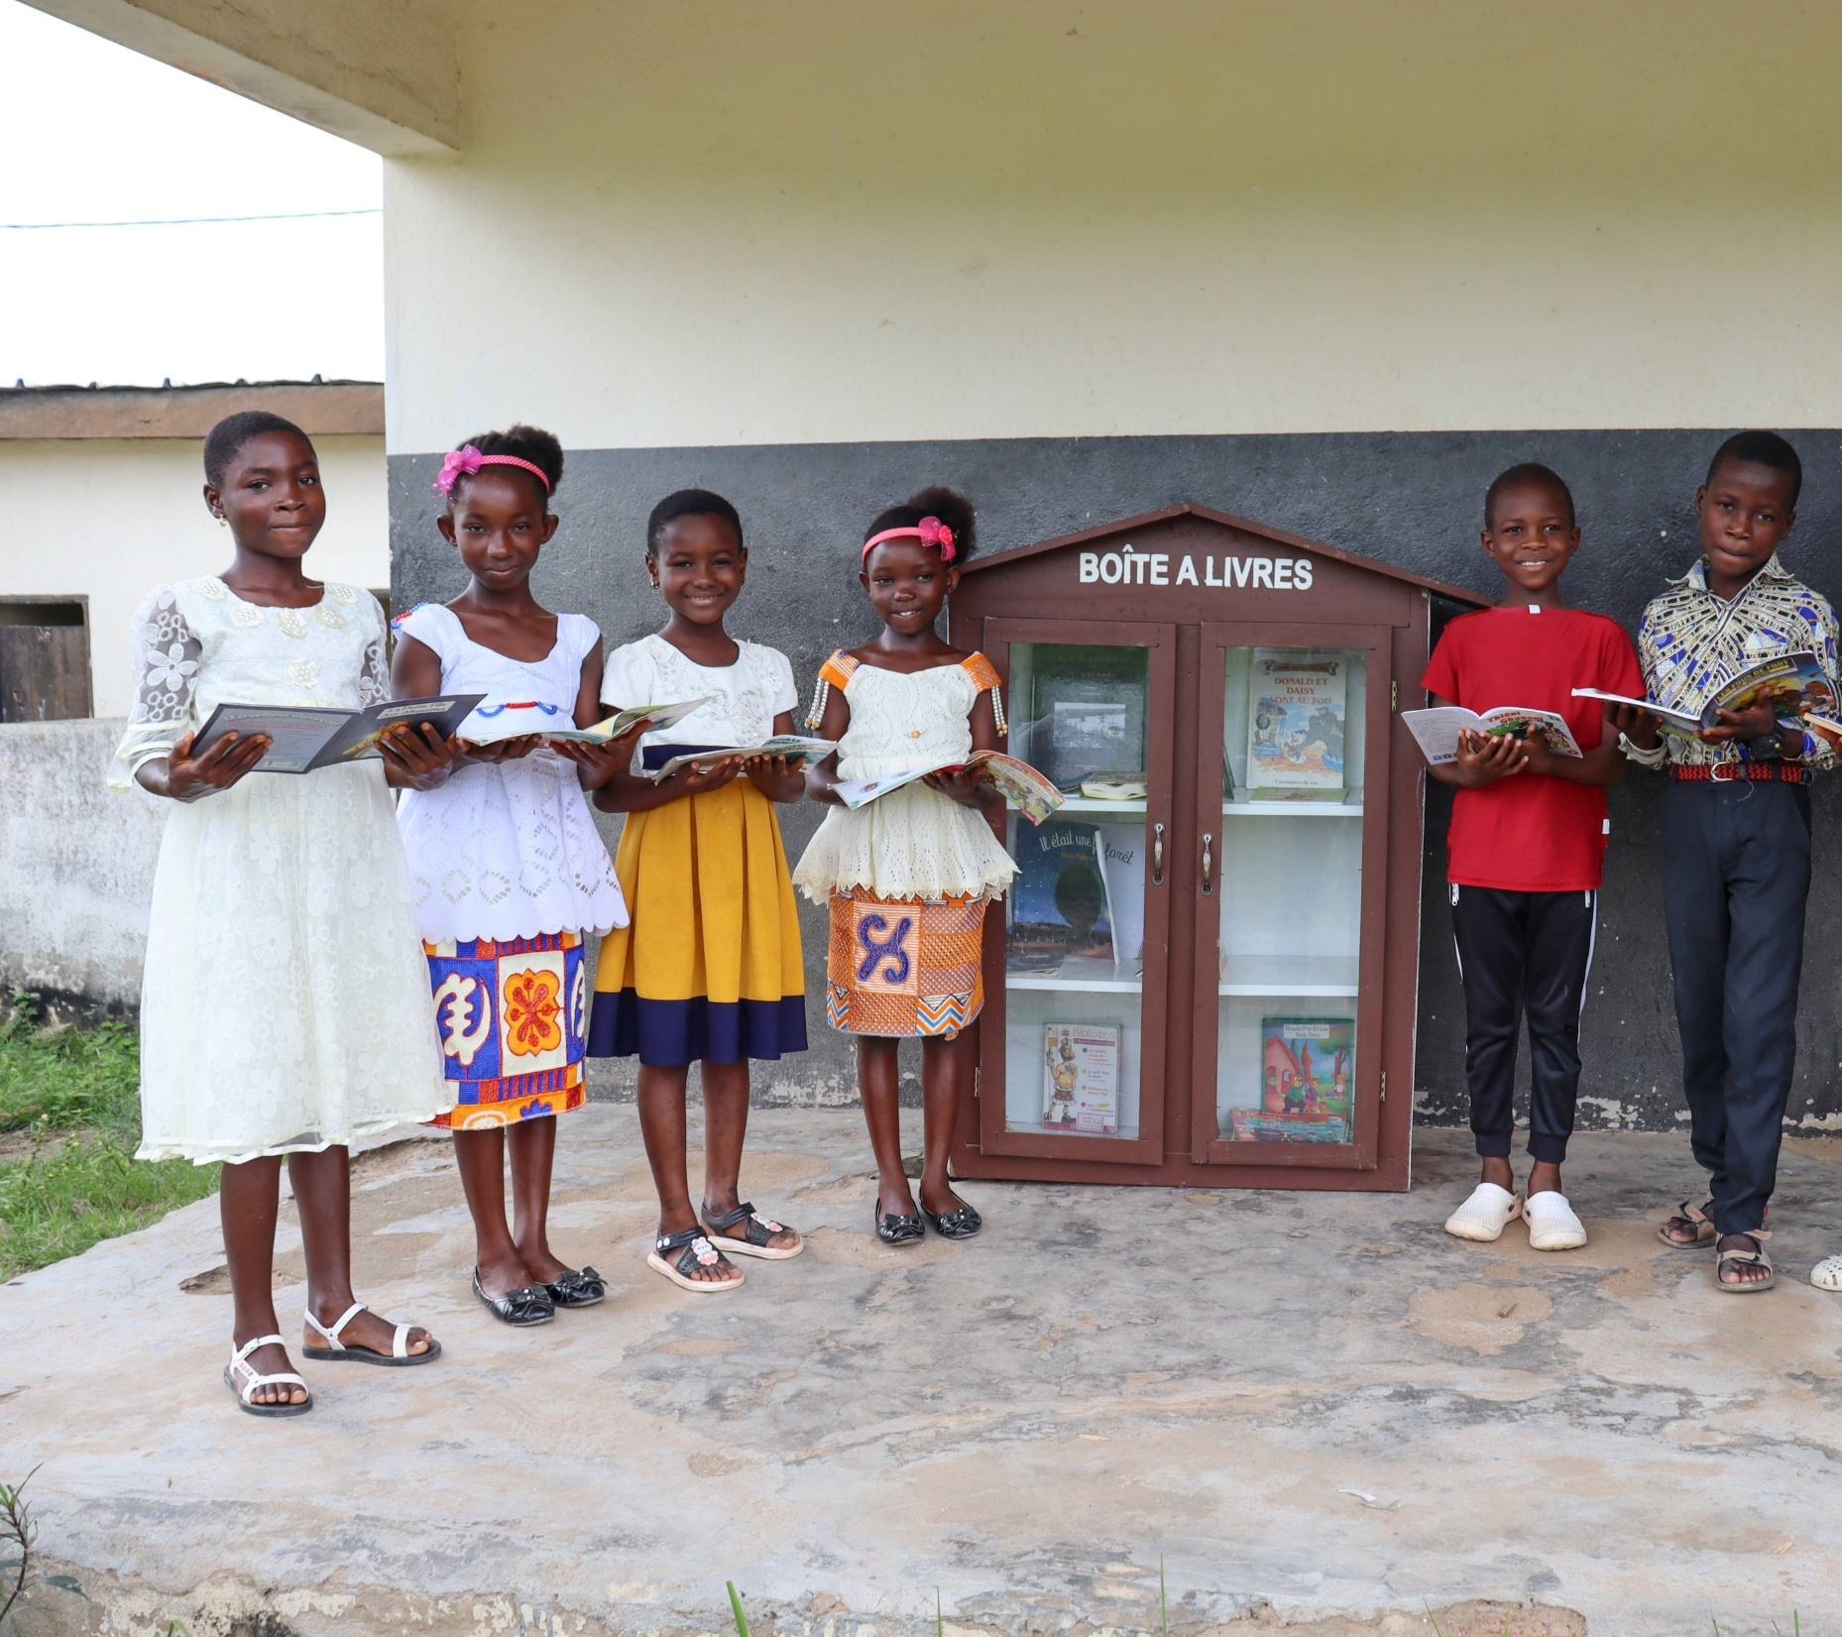
Key findings:
Who participated?

Slide 7
481 out of 765 students in the treatment group participated in Boîte à Livres activities, including borrowing books
Girls participated in the activities as much as boys
The children in higher school grades participated more in activities
Children who participated were the most skilled at baseline
The average age for students participating in activities was 11

Slide 8
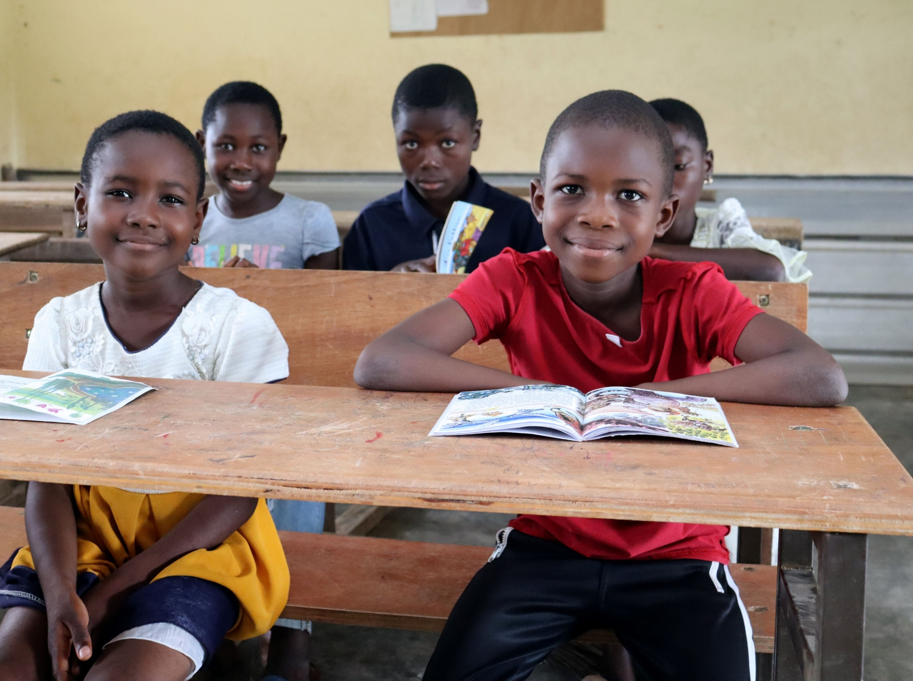
Key findings:
Did the Boîte à Livres affect children’s reading skills?

Slide 9
Increase in average reading score by participation in the Boîte à Livres activities
Reading skills improved for all students, but even more so for those who participated in the Boîte à Livres activities

Slide 10
At baseline, the difference in reading ability between the treatment and control groups was small (2pp). By endline, this gap widened significantly to 12pp, indicating a much greater improvement in the treatment group compared to the control group.

Slide 11
Students in the treatment group improved reading skills by 0.47 points (p < 0.05*) more than the control group, regardless of age, school level, gender, or initial reading skills.
Reading skills steadily improve from one class to the next. However, the older the student, the smaller the margin for progress, i.e.: progress is greater at age 6 than at age 14.
Being a boy or a girl does not affect the improvement in reading skills.

Slide 12
“I’ve seen an improvement in my daughter’s grades, reading makes it easier to learn her lessons.”
Cocoa farmer and parent of a girl participating in the Boîte à Livres activities

Slide 13
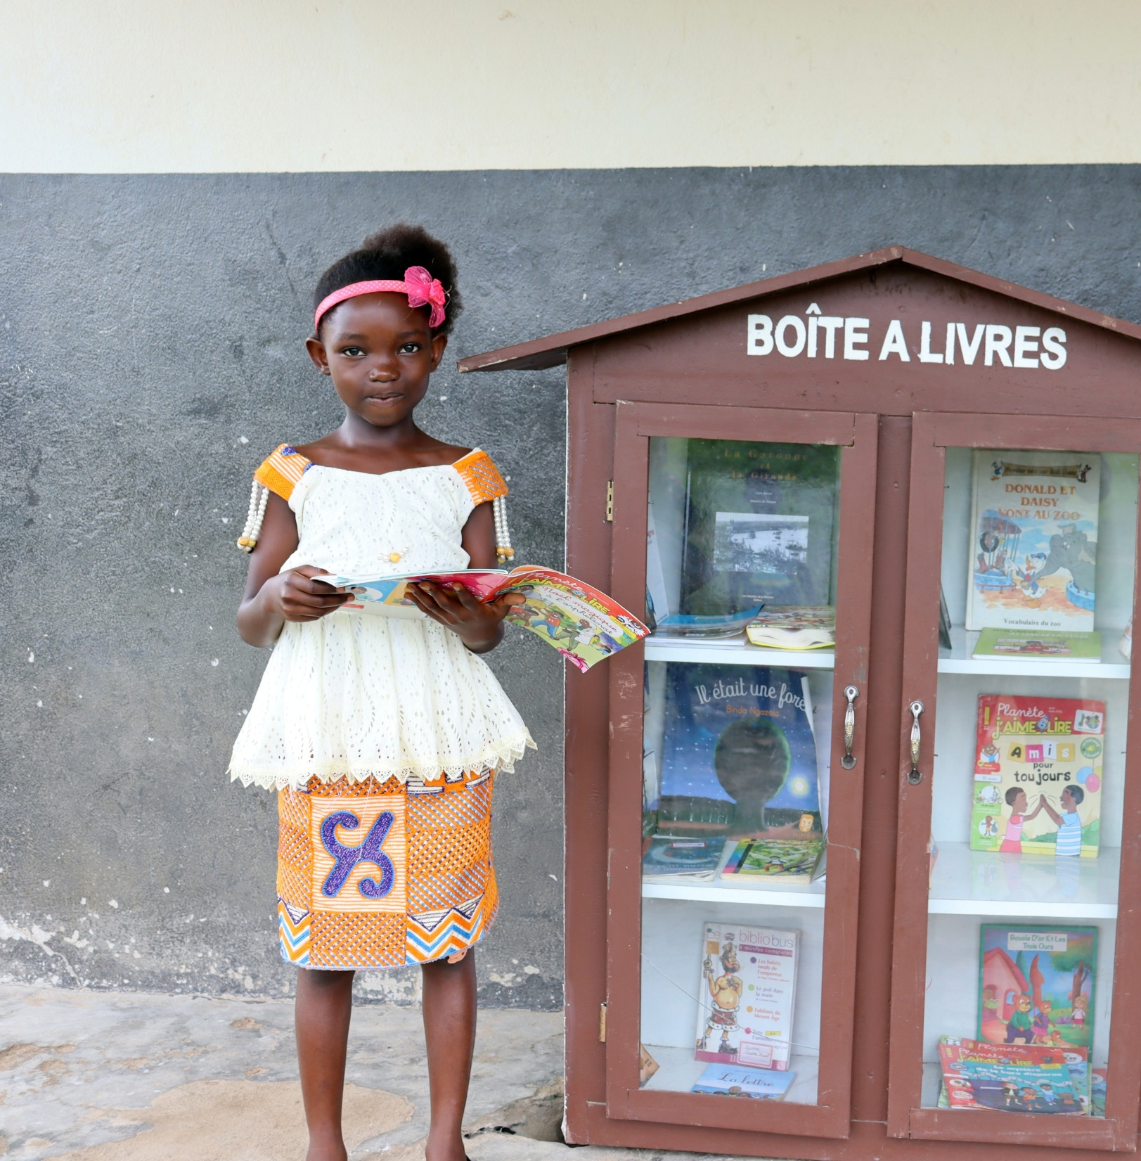
Key findings:
Did the Boîte à Livres have an impact on child labour?

Slide 14
Engagement in child labour slightly decreased among children in treatment communities who participated in the Boîte à Livres activities…
Time spent working slightly decreased among children in treatment communities who participated in the Boîte à Livres activities…
Participated
Did not participate
…and increased among those in treatment and control communities who did not participate.
…and increased among those in treatment and control communities who did not participate.

Slide 15
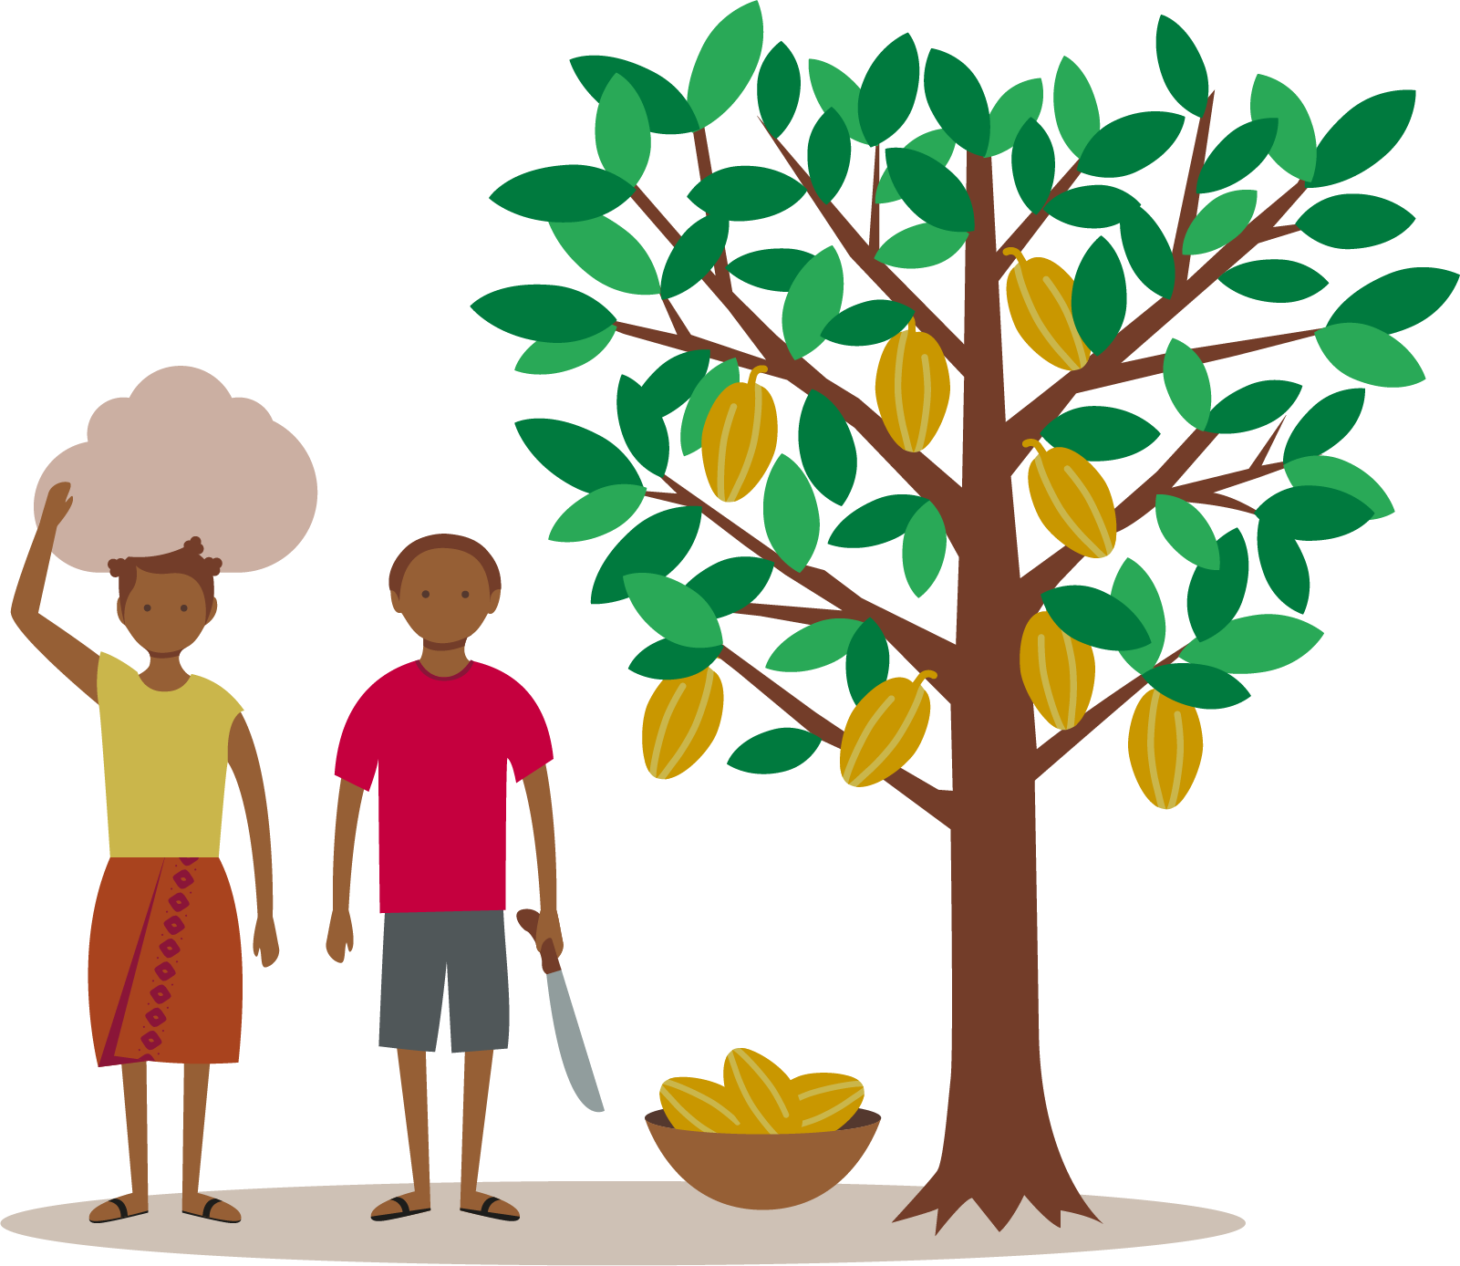
While there was a slight decrease in child labour among children participating in Boîte à Livres activities, this change is not statistically significant. The intervention did not have a measurable impact on children’s involvement in child labour, regardless of their sex, age, or school grade.
However, the results indicate an opportunity: integrating child labour components into the project and increasing efforts to onboard children most in need could enhance its impact.

Slide 16
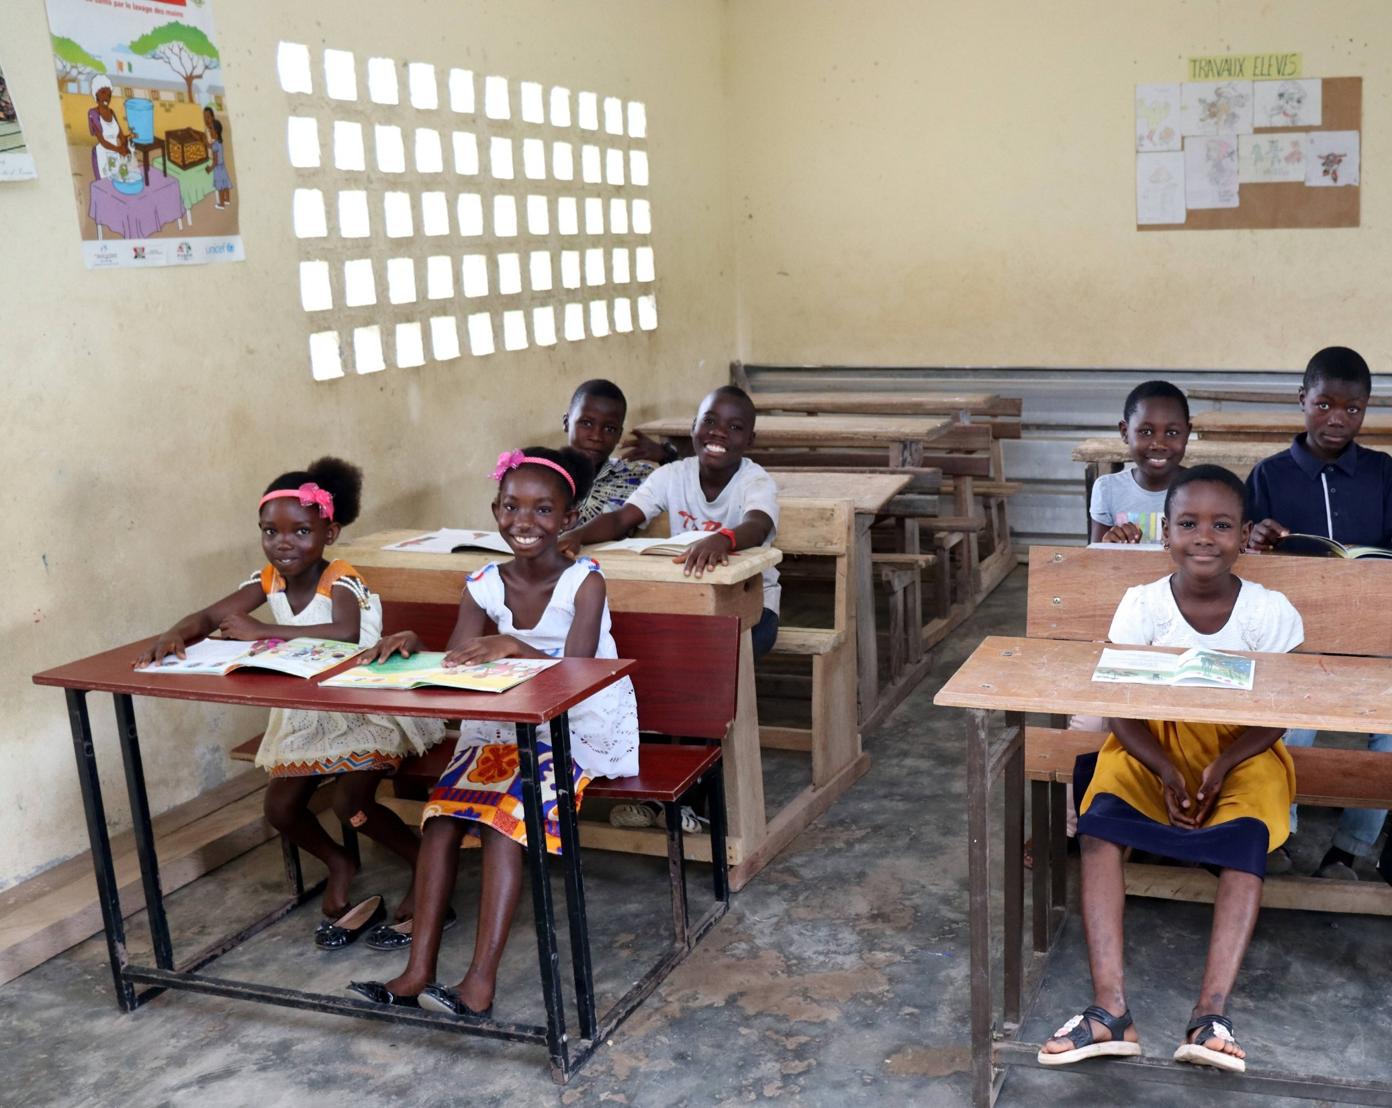
Conclusions

Slide 17
Effects of the Boîte à Livres
Improved reading skills
Boîte à Livres
Children’s participation in workshops and increased reading activities
Reduced time spent working in the fields
Confirmed effect
Not confirmed effect

Slide 18
What does this mean?
While it is essential to reduce the prevalence of child labour, it is equally important to prevent its harmful effects on children's development.
Creating a nurturing environment plays a key role in protecting children from the negative impacts of child labour. Initiatives like the Boîte à Livres are important for promoting children’s healthy development.
Children's reading skills improved from borrowing books and attending the weekly reading workshops
Children's engagement in child labour did not change from participating in Boîte à Livres activities

Slide 19
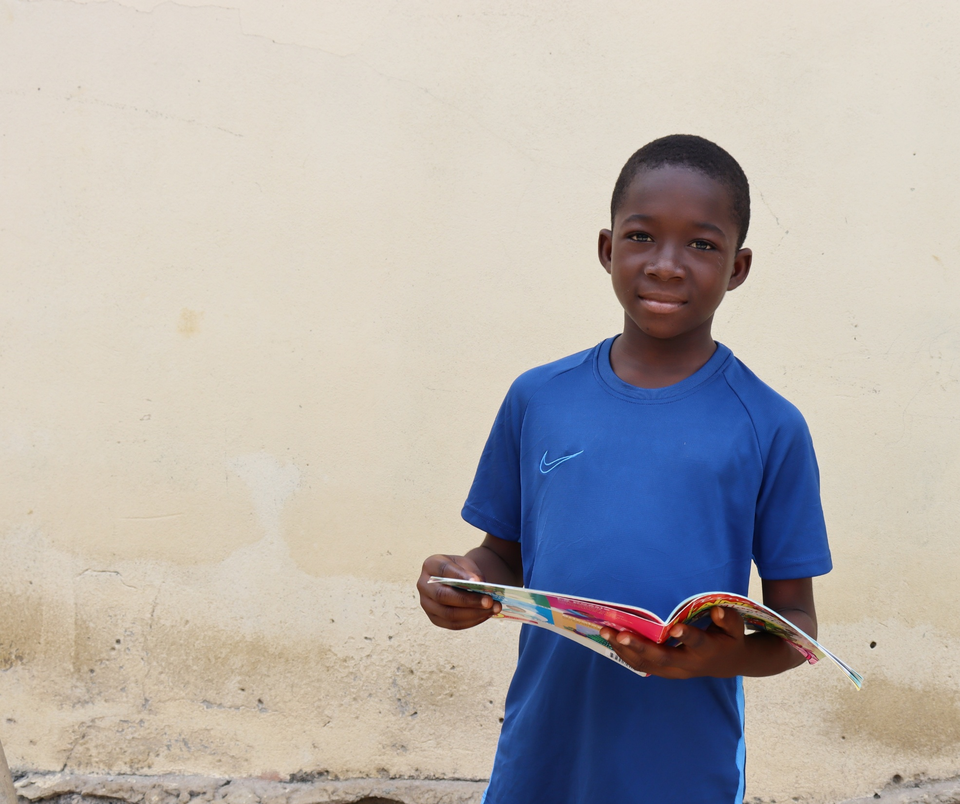
Recommendations

Slide 20
Integrate a child labour component into the project design
Combining the Boîte à Livres with awareness-raising on child labour would help caretakers connect the Boîte à Livres and the fight against child labour, contributing to encouraging behaviour change. The awareness-raising messages should be positive and encouraging and should be addressed at caregivers and teachers.
Encourage everyone to participate
Involve cooperatives in mobilising farmers' children to take part in Boîte à Livres activities.
Address barriers to ensure that the youngest children and those with the greatest reading difficulties have the same access to Boîte à Livres as those who have higher reading skills.

Slide 21
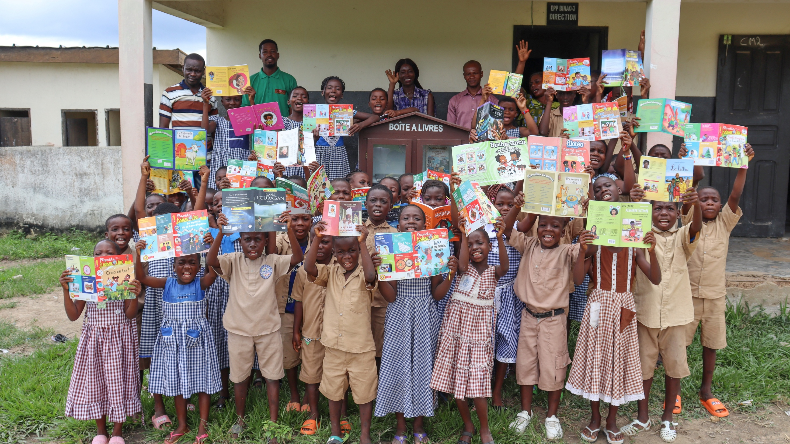

Slide 22
Average reading score by category
At the beginning, all students had similar reading skills, but the treatment group showed a significant improvement in their reading abilities at endline.
An additional 20% of students in treatment schools passed all the reading tests (compared to control)
Reading
Syllable
Word
Sentence
Paragraph 1
Paragraph 2
Summary 1
Summary 2
Control - Baseline
Treatment - Baseline
Control - Endline
Treatment - Endline

Slide 23
Reading skills were similar for all students at baseline…
…but the reading skills of the treatment group increased significantly at endline
Summary 2
Summary 1
Summary 1
Summary 2
An additional 20% of students in treatment schools passed all the reading tests (compared to control)

